Slide 1

Winpath3 Provider Bridging Demo
MBD Apps

Slide 2
Agenda
Phase 1 Bridging Demo System Features
System setup
Learning scenario
Aging Scenario
Flooding Scenario
Multicast Scenario
Learning performance check
Features to be supported in Phase 2

Slide 3
Bridging Demo System Features –
Phase I
2xXAUI ports on IXIA( currently only 1 is available)
WP3 device
Linux based Demo
10xSGMII ports and 1xXAUI ports on WDS3
Layer 2 switch which distributes traffic from XAUI port on the ixia to 10 gige ports based on VLAN and vise versa.
Interworking Bridging system with IWGP
Multiple VLANs per interface
Max MAC support per Interworking port
Automatic creation of Forwarding + learning rules.
Aging support per forwarding rule. Each rule can have its own weight.
Aging and learning are done by separate threads.
Unknown unicast/multicast traffic flooding
Dynamic operation support (creating multicast/flooding groups, Get PCE forwarding rules etc).
G.8032 protection (delete all rules for a specific VLAN)

Slide 4
System Setup - diagram
IXIA
XAUI port 1
XAUI
Switch
uplink
Downlink
10XSGMII
WDS3
XAUI
XAUI port 2
IXIA

Slide 5
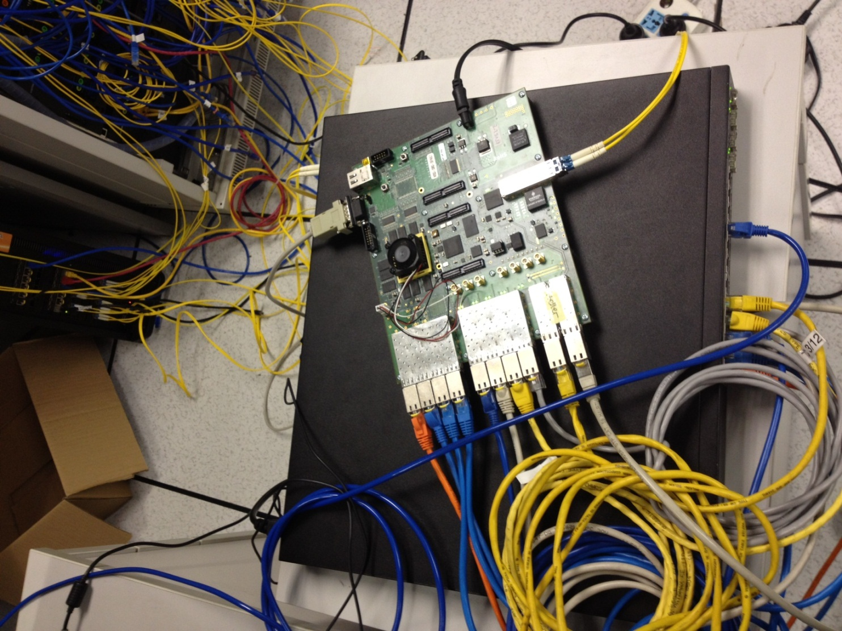
System Setup – physical setting

Slide 6
System Setup - uplink flow diagrams
VLAN Aware Bridging System
SGMII
ports
SGMII
Devices
PCE Filter Sets
IW Bport
VLAN MC FlowAgg
Flow Aggs
Filter for VLAN flooding
Flow Aggs
Tx Channel
Tx Channel
Devices
Ports
Rx Channel
Devices
Ports
IW Bport
Filter for learning flow agg
IW Bport
MC FlowAgg
Learning filter
XAUI Device
XAUI Port
Forwarding filter
IW Bport
Flow
Agg
Tx Channel

Slide 7

System Setup - Downlink flow diagrams
.
.
.
VLAN Aware Bridging System
VLANMC Flow Agg
Tx Channels
IW Bport
Flow Agg
Tx Channels
Devices
Ports
Flow Agg
Devices
Ports
XAUI
PORT
XAUI
DEVICE
PCE Filter sets
VLAN Aware Bridging Interworking System
MC Flow Agg
Tx Channels
Flow Agg
Tx Channels
Filter for VLAN flooding
IW Bport
Flow Agg
Devices
Devices
Ports
Ports
Rx Channel
IW Bport
Filter for learning flow agg
IW Bport
FlowAgg
Tx Channel
Device
Port
Learning filter
Forwarding filter
.
.
.
.
IW Bport
FlowAggr
Tx Channel
Device
Port

Slide 8
Learning scenario – Expected results
Send 5 Gige traffic from each IXIA port, the traffic is divided into 10 flows from each port, which with VLAN 1 to 10.
Each flow sent from one XAUI port has a corresponding flow sent from the other XAUI port with the same VLAN and swapped Source and MAC addresses.
The traffic will be distributed by the switch based on VLAN to each one of the SGMII ports. VLAN 1 to port1,VLAN 2 to port 2 etc.
Learning will be done based on Source MAC+VLAN. As a result the traffic received on each SGMII port will be forwarded to the XAUI port and traffic received on the XAUI port will be distributed to all SGMII ports.

Slide 9
Learning scenario – test steps
Step 1: Setup the switch:
SGMII port0, XAUI port in VLAN 101, SGMII port1, XAUI port in VLAN 102
SGMII port2, XAUI port in VLAN 103, SGMII port3, XAUI port in VLAN 104
SGMII port4, XAUI port in VLAN 105, SGMII port5, XAUI port in VLAN 106
SGMII port6, XAUI port in VLAN 107, SGMII port7, XAUI port in VLAN 108
SGMII port8, XAUI port in VLAN 109, SGMII port9, XAUI port in VLAN 110
Step 2: Step the Bridging system. Same port-VLAN mapping as switch.
Step 3: Enable learning in Bridging system.
Step 4: Send 5 gige traffic from the IXIA connected to the Switch with the following packet flows:
  Source MAC 00:00:00:00:00:01 Dest MAC: 00:00 00:00:00:00:01:01 VLAN 101
  Source MAC 00:00:00:00:00:01 Dest MAC: 00:00 00:00:00:00:01:01 VLAN 102
  Source MAC 00:00:00:00:00:01 Dest MAC: 00:00 00:00:00:00:01:01 VLAN 103
  Source MAC 00:00:00:00:00:01 Dest MAC: 00:00 00:00:00:00:01:01 VLAN 104
  Source MAC 00:00:00:00:00:01 Dest MAC: 00:00 00:00:00:00:01:01 VLAN 105
  Source MAC 00:00:00:00:00:01 Dest MAC: 00:00 00:00:00:00:01:01 VLAN 106
  Source MAC 00:00:00:00:00:01 Dest MAC: 00:00 00:00:00:00:01:01 VLAN 107
  Source MAC 00:00:00:00:00:01 Dest MAC: 00:00 00:00:00:00:01:01 VLAN 108
  Source MAC 00:00:00:00:00:01 Dest MAC: 00:00 00:00:00:00:01:01 VLAN 109
  Source MAC 00:00:00:00:00:01 Dest MAC: 00:00 00:00:00:00:01:01 VLAN 110

Slide 10
Learning scenario – test steps
Step 4: Send 5 gige traffic from the IXIA connected to the WDS3 board with the following packet flows:
  Source MAC 00:00:00:00:01:01 Dest MAC: 00:00 00:00:00:00:00:01 VLAN 101
  Source MAC 00:00:00:00:01:01 Dest MAC: 00:00 00:00:00:00:00:01 VLAN 102
  Source MAC 00:00:00:00:01:01 Dest MAC: 00:00 00:00:00:00:00:01 VLAN 103
  Source MAC 00:00:00:00:01:01 Dest MAC: 00:00 00:00:00:00:00:01 VLAN 104
  Source MAC 00:00:00:00:01:01 Dest MAC: 00:00 00:00:00:00:00:01 VLAN 105
  Source MAC 00:00:00:00:01:01 Dest MAC: 00:00 00:00:00:00:00:01 VLAN 106
  Source MAC 00:00:00:00:01:01 Dest MAC: 00:00 00:00:00:00:00:01 VLAN 107
  Source MAC 00:00:00:00:01:01 Dest MAC: 00:00 00:00:00:00:00:01 VLAN 108
  Source MAC 00:00:00:00:01:01 Dest MAC: 00:00 00:00:00:00:00:01 VLAN 109
  Source MAC 00:00:00:00:01:01 Dest MAC: 00:00 00:00:00:00:00:01 VLAN 110
  Step 5: check statistics of WDS port 0 to port 9 and XAUI port
  Step 6: dump all entries learned

Slide 11
G.8032 protection
  What we do to G.8032?
  delete all rules per VLAN
  And How?
  In main menu, input command “7” to flush all dynamic PCE rules for a specific VLAN

Slide 12
Aging Scenario – Expected results
  Run learning Scenario and set the aging weight for each learned entry to be 1
  Enable Aging with period of 1s with
  Stop traffic
  Check after 1s that the PCE FDB data base is empty.
  Repeat previous steps with weight set to 10.
  Check that after 10s the PCE FDB data base is empty.

Slide 13
Aging Scenario – Test Steps
  Step 1: Set aging period to be “1” second.
  Step 2: Set aging weight to be “1”.
  Step 3: Enable Aging.
  Step 4: Run learning traffic.
  Step 5: Stop traffic, wait 1 second and dump PCE FDB.
  Step 6: Set aging weight to be “10”
  Step 7: Run learning traffic.
  Step 8: Stop traffic, wait 10 seconds and dump PCE FDB.

Slide 14
Aging Scenario – Aging performance
  “Aging : Already aging out 16000 rules, in Time delta (in micro sec) 86056”
  It takes 86056 μs to age all 16k rules.

Slide 15
Flooding Scenario – Expected results
  Define 2 flooding groups for VLAN 101 and VLAN 20 with the following members:
    Port 1, 5 and 10.
    XAUI port
  Send untagged traffic to the XAUI port on WDS3 whose default VLAN is 20.
  Check traffic is flooded to all ports in the flooding group except the XAUI port.
  Send traffic with VLAN 101 from the Ixia connected to the switch.
  The switch will forward the traffic to SGMII port 1.
  Check traffic is flooded to all ports in the flooding group except SGMII port 1.

Slide 16
Flooding Scenario – Test Steps
  Step 1: Create VLAN 101 with port 0, 4, 9 and XAUI port; create VLAN 20 with the same ports as VLAN 10.
  Step 2: Set the default VLAN tag of WDS XAUI port to be 20
  Step 3: Set a flow of untagged traffic and send from the port connected to WDS XAUI port
  Step 4: Check statistics of WDS port 0, 4, 9 and XAUI port
  Step 5: Set VLAN 101 in switch with XAUI port and port connect to port 0 of WDS3 board
  Step 6: Set a flow of with VLAN 10 from the Ixia connected to the switch.
  Step 7: Check statistics of WDS port 0, 4, 9 and XAUI port

Slide 17
Learning performance check – Expected results
Send 10 gige traffic from ixia with 16k packet flows:
  Send 1600 packet flows on each VLAN
  source MAC should change between 00:00:00:00:00:00-00:00:00:00:06:40 per VLAN.
The traffic will be distributed by the switch based on VLAN. VLAN 1 to port1,VLAN 2 to port 2 etc.
Learning will be done based Source MAC +VLAN. The traffic received will go to the default flow aggregation which was defined per port.
The default flow aggregation per port send the traffic to the Uplink XAUI port.
Check the time it takes to learn 16k entries.

Slide 18
Learning performance check – Test Steps
  Step 1: use step 1 to 3 of Learning scenario to configure the system.
  Step 2: Start performance test
  Step 3: in IXIA setup 16000 flows on each VLAN with MAC address changes from 00:00:00:00:00:00 to 00:00:00:00:06:40 per VLAN
  Step 4: send the above traffic from XAUI port connect to Switch XAUI port.
  Step 5: check the time it takes to learn 16k flows.

Slide 19
Learning performance check
interrupt mode
time(μs ) | 64 bytes | 128 bytes | 256 bytes | 512 bytes | 1024 bytes | 1500bytes
10G | NA | NA | NA | 267349 | 280787 | 294643
5G | NA | NA | 266002 | 290089 | 291321 | 288541
3G | NA | 253076 | 278927 | 288828 | 305209 | 292757
1G | 278628 | 285158 | 289068 | 292215 | 312645 | 336548
polling mode
time(μs ) | 64 bytes | 128 bytes | 256 bytes | 512 bytes | 1024 bytes | 1500bytes
10G | NA | NA | NA | 230431 | 255478 | 274937
5G | NA | NA | 230472 | 234501 | 243465 | 252765
3G | NA | 238193 | 238768 | 250449 | 255428 | 268524
1G | 240166 | 267745 | 253983 | 269497 | 302605 | 336122

Slide 20
Features to be supported in Phase 2
  RSTP/MSTP and port control
  VSI Bridging with double VLAN support

Slide 21


